Slide 1

The CARET package
STA 4143
Data Mining

Slide 2
Caret functionality
Some preprocessing (cleaning)
preProcess
Data splitting
createDataPartition
createResample
createTimeSlices
Training/testing functions
train
predict
Model comparison
confusionMatrix

Slide 3
Machine learning algorithms in R
Linear discriminant analysis
Regression
Naïve Bayes
Support vector machines
Classification and regression trees
Random forests
Boosting
etc

Slide 4
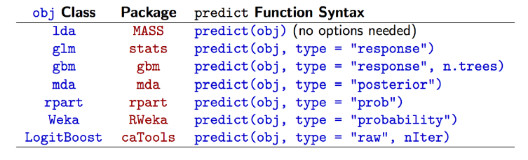
Why caret?
http://edii.uclm.es/~useR-2013/Tutorials/kuhn/user_caret_2up.pdf

Slide 5
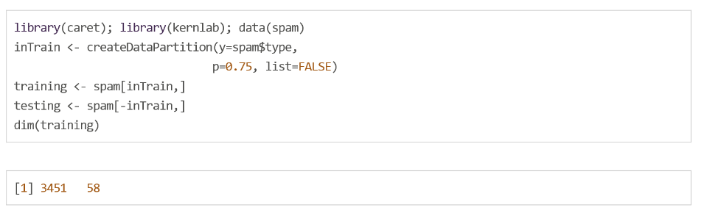
SPAM Example: Data splitting

Slide 6
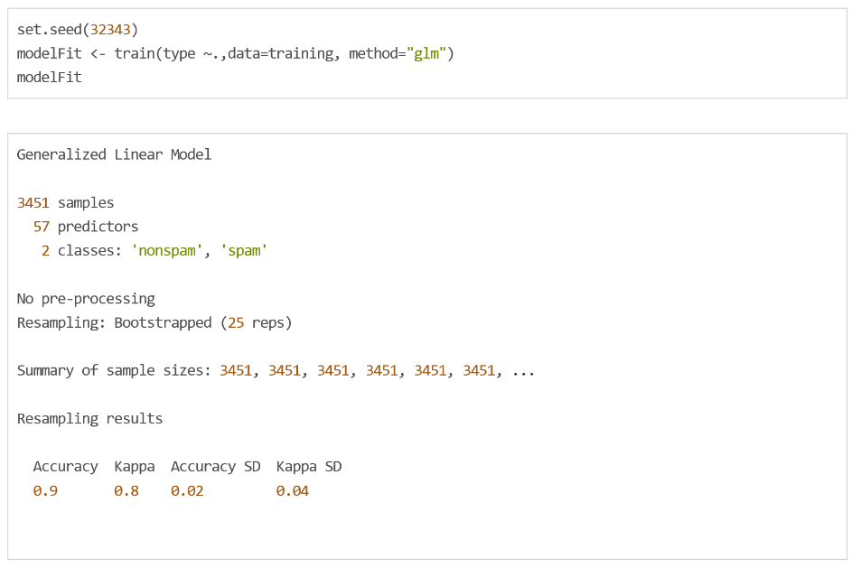
SPAM Example: Fit a model

Slide 7
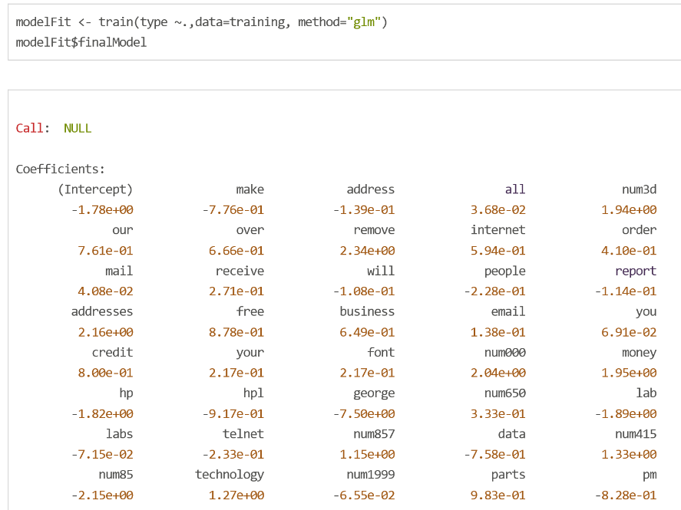
SPAM Example: Final model

Slide 8
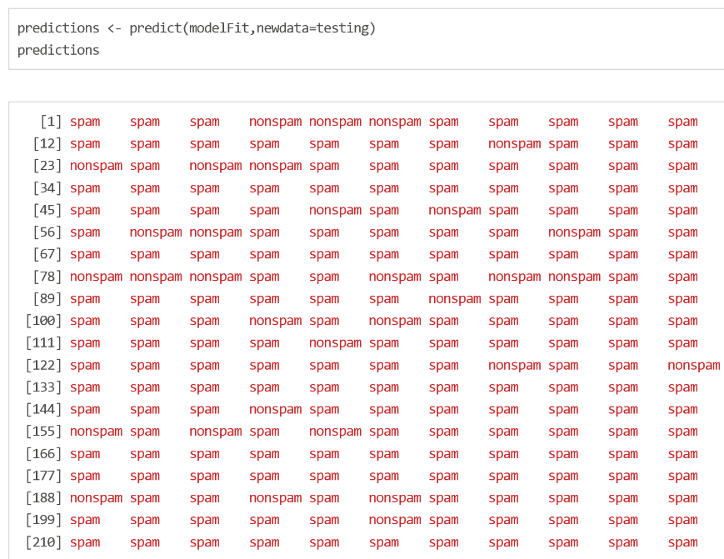
SPAM Example: Prediction

Slide 9
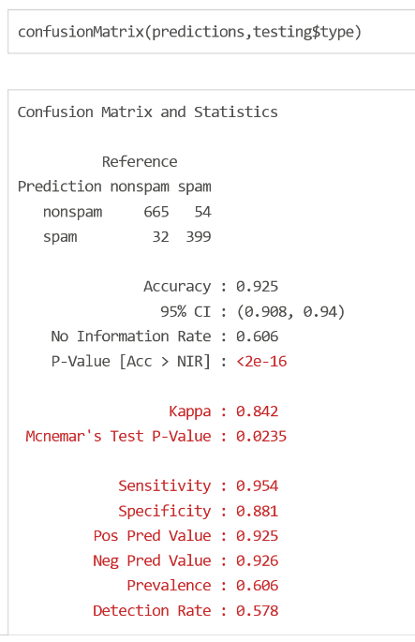
SPAM Example: Confusion Matrix

Slide 10
Data slicing
STA 4143
Data Mining

Slide 11
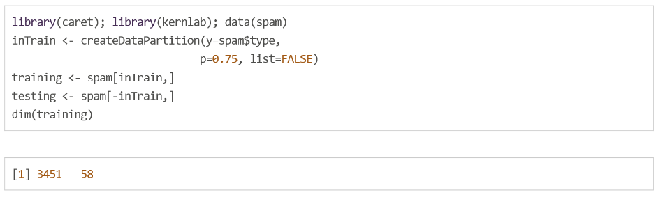
SPAM Example: Data splitting

Slide 12
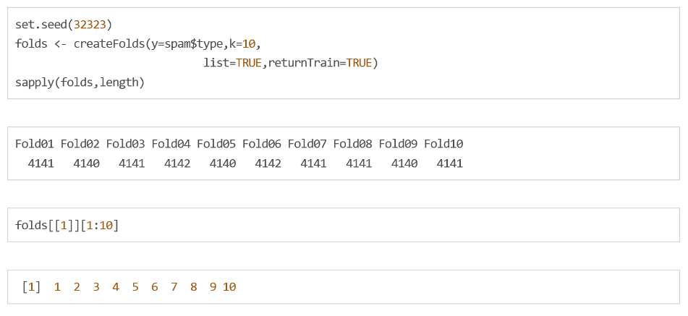
SPAM Example: K-fold

Slide 13
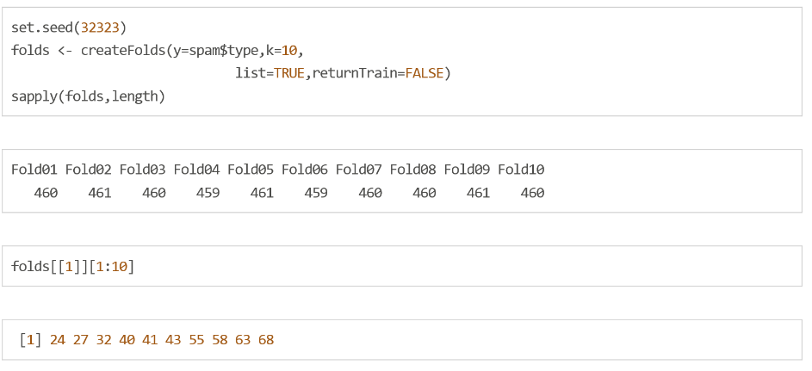
SPAM Example: Return test

Slide 14
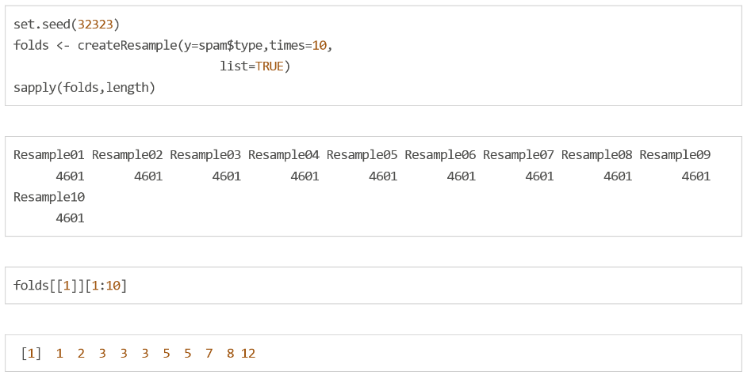
SPAM Example: Resampling

Slide 15
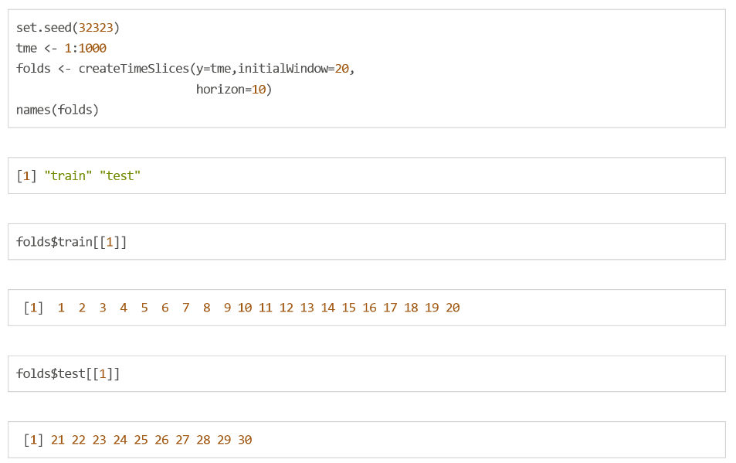
SPAM Example: Time Slices

Slide 16
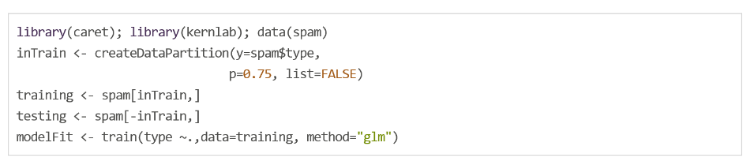
Options for Training
SPAM Example

Slide 17
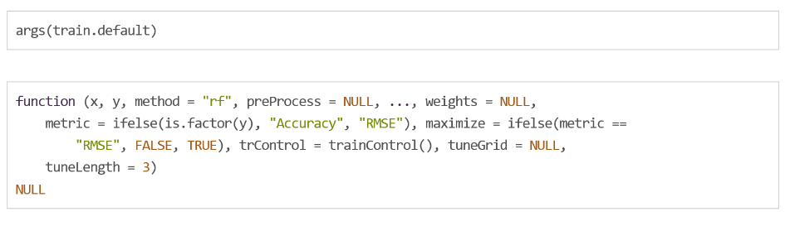
Train options

Slide 18
Metric options
Continuous outcomes:
RMSE = Root mean squared error
Rsquared = R² from regression models
Categorical outcomes:
Accuracy = Fraction correct
Kappa = A measure of concordance

Slide 19
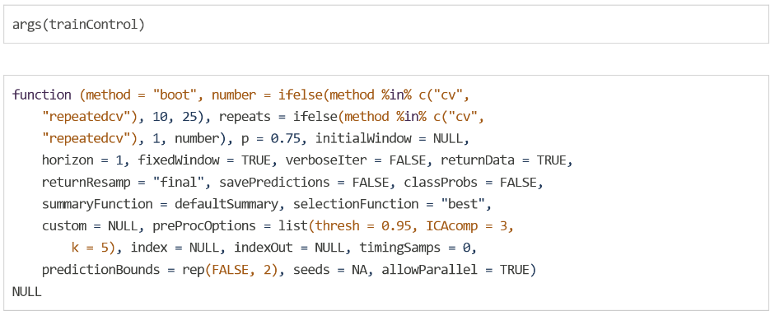
trainControl

Slide 20
trainControl resampling
method
boot= bootstrapping
boot632 = bootstrapping with adjustment
cv = cross validation
repeatedcv = repeated cross validation
LOOCV = leave one out cross validation
number
for boot/cross validation
Number of subsamples to take
repeats
Number of times to repeate subsampling
If big this can slow things down

Slide 21
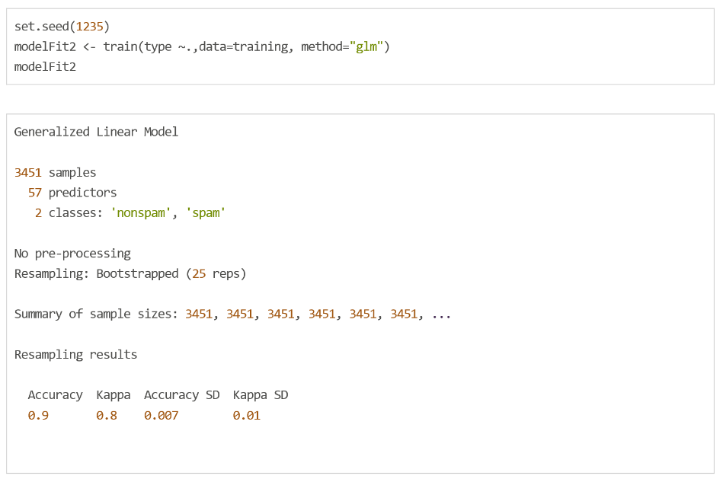
Setting the seed
It is often useful to set an overall seed
You can also set a seed for each resample
Seeding each resample is useful for parallel fits

